Slide 1

SMART ALARM SYSTEM
- GROUP 007
By Musa Shogunle, Milind Bhonsale, and Vishruth Acharya
This Photo by Unknown author is licensed under CC BY-NC.

Slide 2

MOTIVATION FOR ADOPTION
Problem Statement:
Homeowners across the U.S. continue to fall victim of burglary.
833,280 burglaries were recorded in 2021 alone (9 of 1000 families)
In 2022, the number jumped to 847,522
Victims suffer physical and psychological distress in addition to financial loss
Our smart alarm system will help reduce the high rate of burglary
Business Value:
We aim to provide a proactive approach to home security
Our alarm system provides 24/7 security: helps secure customers property around the clock
Our system incorporates many devices, all connected to the control panel
Contact/door sensor, RFID reader and tag/key, security siren, and glass break sensor
Product and services not only safeguard their assets and property: Priceless peace of mind
This Photo by Unknown author is licensed under CC BY-SA.

Slide 3
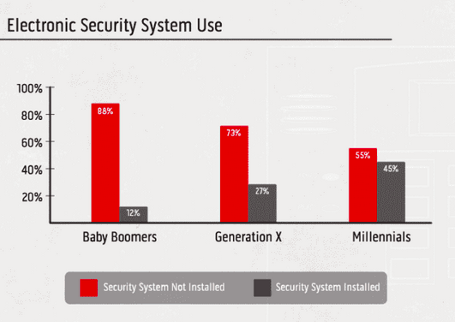
BUSINESS SITUATION
Competition:
ADT Inc.: alarm monitoring services for homes and small businesses across the U.S.
Cove Smart, LLC: offers professional equipment and services across the U.S.
Alarm system, indoor and outdoor cameras, environmental and anti-burglary sensors, and medical alerts
Rhombus Inc.: offers security equipment and remotely manages cameras, sensors, access control, and alarms from a central platform
Target Market:
Our target market is households and small businesses
Estimated 131.43 million homes, 33.3 million small businesses
About 28% of U.S households currently have an electronic security system
Our marketing campaign will include Gen Z
This Photo by Unknown author is licensed under CC BY-SA.

Slide 4
IOT TECHNOLOGY
5V/12V Direct current
Notification Alert
Hardware
Communication
Storage(Cloud)
Sensors
Analytics/Services
Power Supply
Alarm System
Micro Controllers
Descriptive Analytics
RFID Readers and Tags
On Premises
Motion Sensor
AWS Cloud Services
Contact Sensor
4g Modular
Wifi
RFID Reader

Slide 5
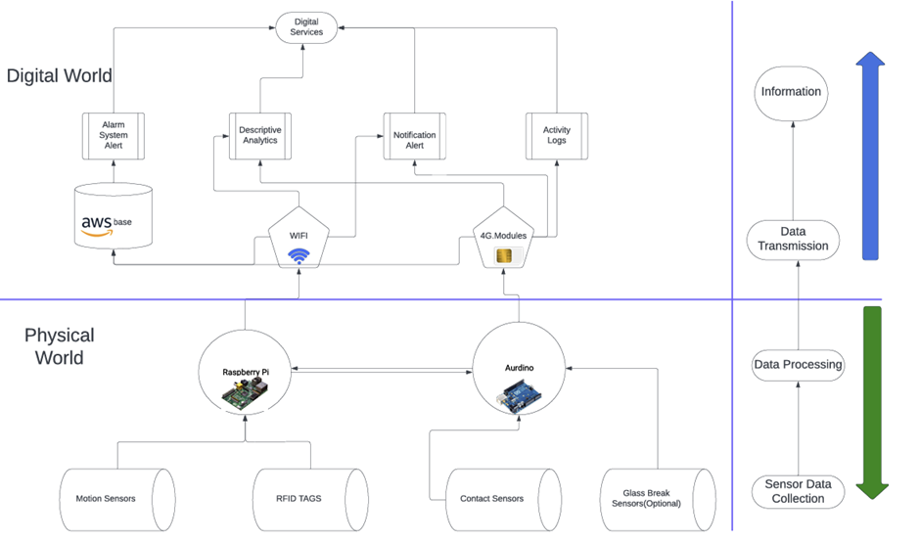
Architecture

Slide 6
Razor Blade Business Model
Initial Sale
Basic hardware kit at a minimal markup and FREE Installation.
Control unit, a set of sensors, and standard RFID tags
Subscription Services
Monthly or yearly premium services post-purchase
Enhanced monitoring features, cloud storage, real-time alerts, and regular system maintenance checks.
Expandable Components
Allowing customizations and expand their systems with additional sensors and advanced RFID tags.
Commit to regular firmware and software updates for maintaining security and functionality.

Slide 7

Revenue Model
We offer our product at a cost that includes total hardware expenses plus a 30% profit margin. Installation is provided free of charge, not only as an attractive feature but also to guarantee optimal device placement and integration.
Our primary revenue stream will come from monthly subscription fees, while the secondary source of value will stem from the data generated by our system. This data will be analyzed to study behavioral patterns, leading to product enhancements and the development of new offerings.

Slide 8
Hardware Cost

Slide 9
Cost of Components
Component | Cost (each) | Range/Use
HF RFID Reader | $800 x 2 | Up to 2 meters
Passive RFID Tags | $5 X 4 | Enable Authentication
Control Unit | $200 | Central control, network range depends on connectivity
Motion Sensors (PIR) | $50 X 2 | 5-12 meters (16-40 feet), 80-100 degrees conical detection
Contact Sensors (Door) | $30 X 2 | Immediate at contact point, detects open/close
Emergency Security Horn/Siren | $10 | The device is triggered when intrusion is detected.
Installation and Setup | $0 | Professional installation for optimal component integration
Additional Sensors (Optional) | $60 each | Expand system as needed

Slide 10
Subscription Fees
Basic Subscription Fee (Monthly) | $25/month | Cloud connectivity, basic event logging, notifications
Maintenance Fee (Yearly) | $15 | Covers regular servicing, firmware updates, minor repairs
Premium Subscription (Optional Monthly) | + $25/month | 24/7 support with priority troubleshooting and additional exclusive features

Slide 11
Cost and Revenue Projection
Standard User:
Cost Price: $1970 + 30% = $2561
Subscription Fee Revenue (2 years): $600
Premium User:
Cost Price: $4030 + 30% = $5239
Subscription Fee Revenue (2 years): $1200
These cost breakdowns and revenue projections are based on the specified components, subscription fees, and optional services outlined in the provided information. Actual costs and revenues may vary depending on specific customer requirements and additional services or features chosen.

Slide 12
SUMMARY
Our smart alarm system represents the fusion of IoT technology with traditional security systems, delivering a sophisticated and user-friendly solution for modern homes and businesses.
Key Features:
Real-time monitoring and intelligent alerts
Seamless integration with smart home devices
Enhanced convenience and peace of mind for users
Robust encryption and authentication for data security
Comprehensive solution for evolving security needs
By embracing IoT advancements, our smart alarm system offers unparalleled functionality, empowering users to protect their homes and businesses with confidence.

